Slide 1
Chapter 2: Basic Structures: Sets, Functions, Sequences, and Sums
Discrete Mathematics and Its Applications
1

Slide 2
2.1 Sets
Introduction
Sets are used to group objects together. Often the objects in a set have similar properties.
Data structures: Array, linked list, boolean variables, …
DEFINITION 1
A set is an unordered collection of objects.
2

Slide 3



2.1 Sets
DEFINITION 2
The objects in a set are called the elements, or members, of the set. A set is
said to contain its elements.
a A: a is an element of the set A.
a A: a is not an element of the set A.
Note: lower case letters are used to denote elements.
3

Slide 4
2.1 Sets
Ways to describe a set:
Use { … } Roaster Method
E.g. {a, b, c, d} – A set with four elements.
V = {a, e, i, o, u} – The set V of all vowels in English alphabet.
O = {1, 3, 5, 7, 9} – The set O of odd positive integers less than 10.
{1, 2, 3, …, 99} – The set of positive integers less than 100.
Use set builder notation: characterize all the elements in the set by stating the property or properties.
E.g. O = { x | x is an odd positive integer less than 10}
O = { x Z⁺| x is odd and x < 10}
4

Slide 5

2.1 Sets
Commonly accepted letters to represent sets
N = {0, 1, 2, 3, …}, the set of natural numbers
Z = {…, -2, -1, 0, 1, 2, …}, the set of integers
Z⁺ = {1, 2, 3, …}, the set of positive integers
Q = {p/q | p Z, q Z, and q ≠ 0}, the set of rational numbers
R, the set of real numbers
Sets can have other sets as members
Example: The set {N, Z, Q, R} is a set containing four elements, each of which is a set.
5

Slide 6

2.1 Sets (Equality)
DEFINITION 3
Two sets are equal if and only if they have the same elements. That is, if
A and B are sets, then A and B are equal if and only if
x(x A↔ x B).
We write A = B if A and B are equal sets.
Example:
Are sets {1, 3, 5} and {3, 5,1} equal?
Are sets {1, 3, 3, 3, 5, 5, 5, 5} and {1, 3, 5} equal?
6

Slide 7
2.1 Sets
Venn Diagrams
Represent sets graphically
The universal set U, which contains all the objects under consideration, is represented by a rectangle. The set varies depending on which objects are of interest.
Inside the rectangle, circles or other geometrical figures are used to represent sets.
Sometimes points are used to represent the particular elements of the set.
U
a
u
V
e
o
i
7

Slide 8
2.1 Sets
Empty Set (null set): a set that has no elements, denoted by ф or {}.
Example: The set of all positive integers that are greater than their squares is an empty set.
Singleton set: a set with one element
Compare: ф and {ф}
Ф: an empty set. Think of this as an empty folder
{ф}: a set with one element. The element is an empty set. Think of this as an folder with an empty folder in it.
8

Slide 9

2.1 Sets (Subset)
DEFINITION 4
The set A is said to be a subset of B if and only if every element of A is
also an element of B. We use the notation A B to indicate that A is a
subset of the set B.
A B if and only if the quantification
x(x A → x B) is true
U
A
B
9

Slide 10
2.1 Sets
every non-empty set S is guaranteed to have at least two subset, the empty set and the set S itself, that is ф S and S S.
THEOREM 1
For every set S,
(i) ф S and (ii) S S
10

Slide 11
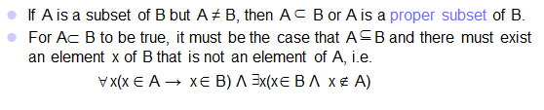
2.1 Sets (Proper subset)
11

Slide 12
2.1 Sets (Cardinality)
DEFINITION 5
Let S be a set. If there are exactly n distinct elements in S where n is a
nonnegative integer, we say that S is a finite set and that n is the
cardinality of S. The cardinality of S is denoted by |S|.
Example:
Let A be the set of odd positive integers less than 10. Then |A| = 5.
Let S be the set of letters in the English alphabet. Then |A| = 26.
Null set has no elements, | ф | = 0.
12

Slide 13
2.1 Sets (Infinite Set)
DEFINITION 6
A set is said to be infinite if it is not finite.
Example: The set of positive integers is infinite.
13

Slide 14
2.1 Sets (Power Set)
DEFINITION 7
Given a set, the power set of S is the set of all subsets of the set S. The
power set of S is denoted by P(S).
Example:
What is the power set of the set {0,1,2}?
Solution: P({0,1,2}) = {ф, {0}, {1}, {2}, {0,1}, {0,2}, {1,2}, {0,1,2}}
What is the power set of the empty set? What is the power set of the set {ф}?
Solution: The empty set has exactly one subset, namely, itself.
P(ф ) = {ф}
The set {ф} has exactly two subsets, namely, ф and the set {ф}.
P({ф}) = {ф, {ф}}
If a set has n elements, its power set has 2^{n} elements.
14

Slide 15
2.1 Sets
Cartesian Products
Sets are unordered, a different structure is needed to represent an ordered collections – ordered n-tuples.
Two ordered n-tuples are equal if and only if each corresponding pair of their elements is equal.
(a₁, a₂,…, a_{n}) = (b₁, b₂,…, b_{n}) if and only if a_{i} = b_{i} for i = 1, 2, …, n
DEFINITION 8
The ordered n-tuple (a₁, a₂,…, a_{n}) is the ordered collection that has a₁
as its first element, a₂ as its second element, …, and a_{n} as its nth
element.
15

Slide 16
2.1 Sets (Cartesian Product)
DEFINITION 9
Let A and B be sets. The Cartesian product of A and B, denoted by A ×
B, is the set of all ordered pairs (a, b), where a A and b B. Hence,
A × B = {(a,b)| a A Λ b B}.
Example:
What is the Cartesian product of A = {1,2} and B = {a,b,c}?
Solution:
A × B = {(1,a), (1,b), (1,c), (2,a), (2,b), (2,c)}
Cartesian product of A × B and B × A are not equal, unless A = ф or B = ф (so that A × B = ф ) or A = B.
B × A = {(a,1),(a,2),(b,1),(b,2),(c,1),(c,2)}
16

Slide 17
2.1 Sets (Cartesian Product)
DEFINITION 10
The Cartesian product of sets A₁, A₂, …, A_{n}, denoted by A₁ × A₂ × …
× A_{n} is the set of ordered n-tuples (a₁, a₂, …, a_{n}), where a_{i} belongs to
A_{i} for i = 1,2, …, n. In other words,
A₁ × A₂ × … × A_{n} = {(a₁, a₂, …, a_{n}) | a_{i} A_{i} for i = 1,2, …, n}.
Example:
What is the Cartesian product of A × B × C where A= {0,1}, B = {1,2}, and C = {0,1,2}?
Solution:
A × B × C= {(0,1,0), (0,1,1), (0,1,2), (0,2,0), (0,2,1), (0,2,2), (1,1,0), (1,1,1), (1,1,2), (1,2,0), (1,2,1), (1,2,2)}
17

Slide 18
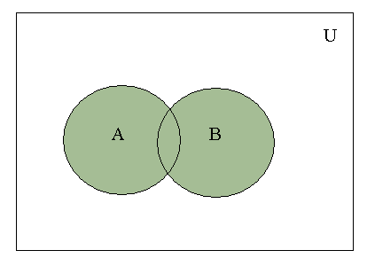
2.2 Set Operations (Union)
DEFINITION 1
Let A and B be sets. The union of the sets A and B, denoted by A U B, is the
set that contains those elements that are either in A or in B, or in both.
A U B = { x | x A v x B}
Shaded area represents A U B.
18

Slide 19
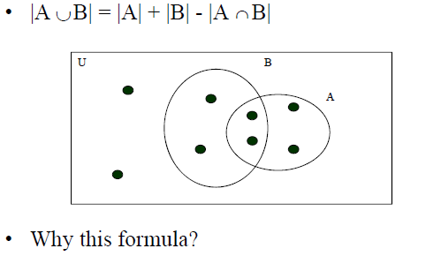
Cardinality of the SET Union
Proof
19

Slide 20
2.2 Set Operations (Union)
Example:
The union of the sets {1,3,5} and {1,2,3} is the set {1,2,3,5}; that is {1,3,5} U {1,2,3} = {1,2,3,5}
The union of the set of all computer science majors at your school and the set of all mathematics majors at your school is the set of students at your school who are majoring either in mathematics or in computer science (or in both).
20

Slide 21
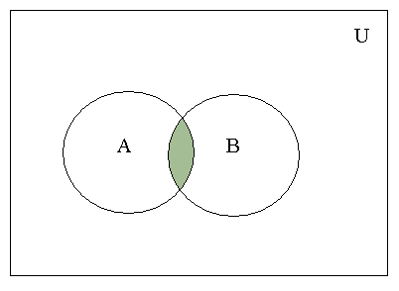
2.2 Set Operations (Intersection)
DEFINITION 2
Let A and B be sets. The intersection of the sets A and B, denoted by A ∩ B,
is the set containing those elements in both A and B.
A ∩ B = { x | x A Λ x B }
Shaded area represents A ∩ B.
21

Slide 22
2.2 Set Operations (Intersection)
Example:
The intersection of the sets {1,3,5} and {1,2,3} is the set {1,3}; that is {1,3,5} ∩ {1,2,3} = {1,3}
The intersection of the set of all computer science majors at your school and the set of all mathematics majors at your school is the set of students at your school who are joint majors in mathematics and in computer science.
22

Slide 23
2.2 Set Operations (Disjoint)
DEFINITION 3
Two sets are called disjoint if their intersection is the empty set.
Example: Let A = {1,3,5,7,9} and B = {2,4,6,8,10}. Because A ∩ B = ф, A and B are disjoint.
23

Slide 24
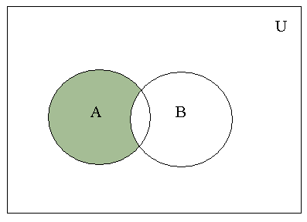
2.2 Set Operations (Difference)
DEFINITION 4
Let A and B be sets. The difference of A and B, denoted by A – B, is the set
containing those elements that are in A but not in B. The difference of A and
B is also called the complement of B with respect to A.
A – B = { x | x A Λ x B}
A – B is shaded.
24

Slide 25
2.2 Set Operations (Difference)
Example:
{1,3,5} - {1,2,3} = {5}
{1,2,3} – {1,3,5} = {2}
The difference of the set of computer science majors at your school and the set of mathematics majors at your school is the set of all computer science majors at your school who are not mathematics majors.
25

Slide 26
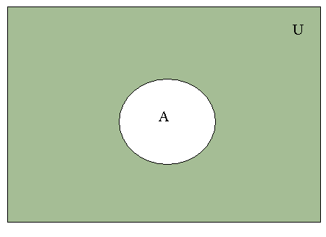
2.2 Set Operations (Complement)
DEFINITION 5
Let U be the universal set. The complement of the set A, denoted by Ā, is the
complement of A with respect to U. In other words, the containing those
complement of the set A is U – A.
Ā = { x | x A }
Ā is shaded.
26

Slide 27
2.2 Set Operations (Complement)
Example:
Let A be the set of positive integers greater than 10 (with universal set the set of all positive integers.)
Then Ā = {1,2,3,4,5,6,7,8,9,10}
27

Slide 28
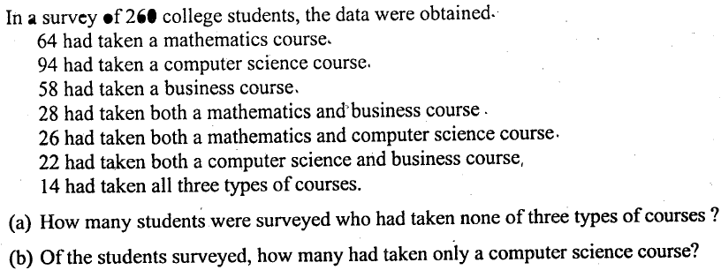
Problem

Slide 29
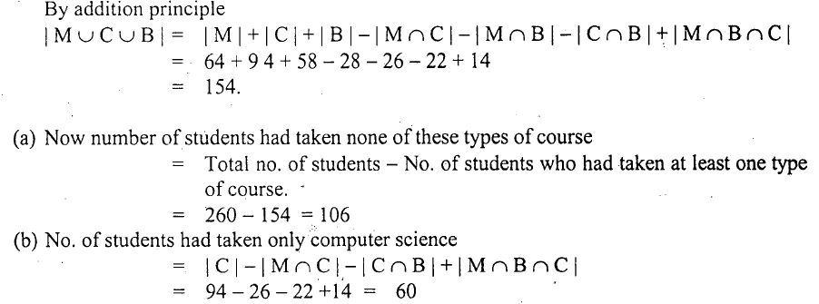
Solution

